Slide 1
Tutorial 6

Slide 2
Topics
Fundamentals of OPAMP

Slide 3
1 What will be the gain factor for a non inverting closed loop op amp.

Slide 4
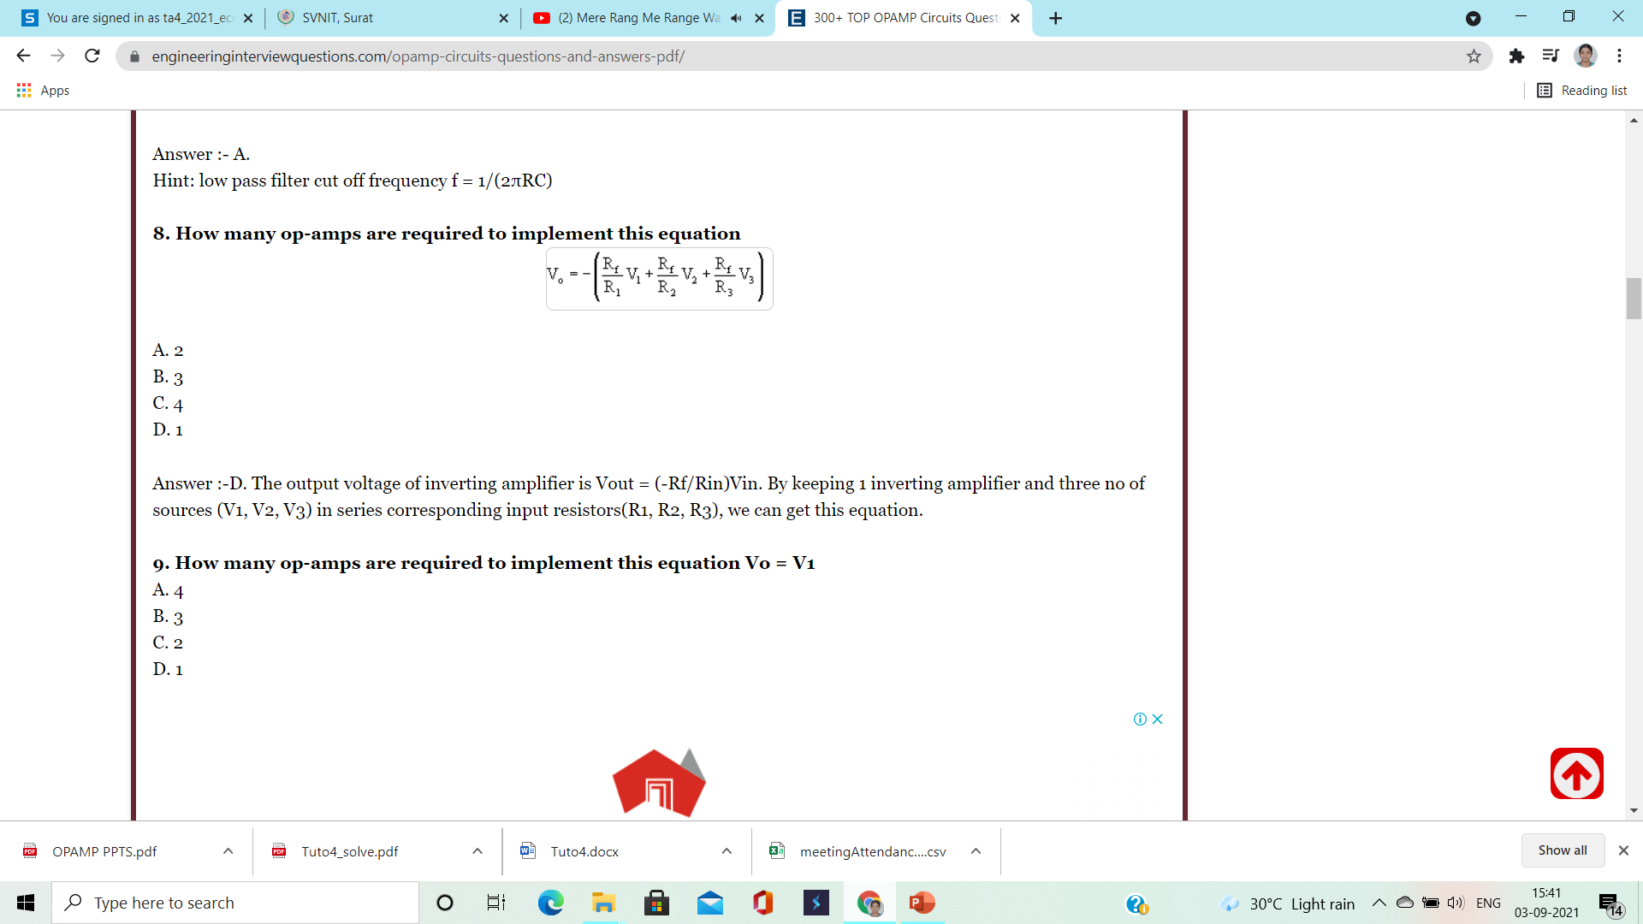
(2)

Slide 5
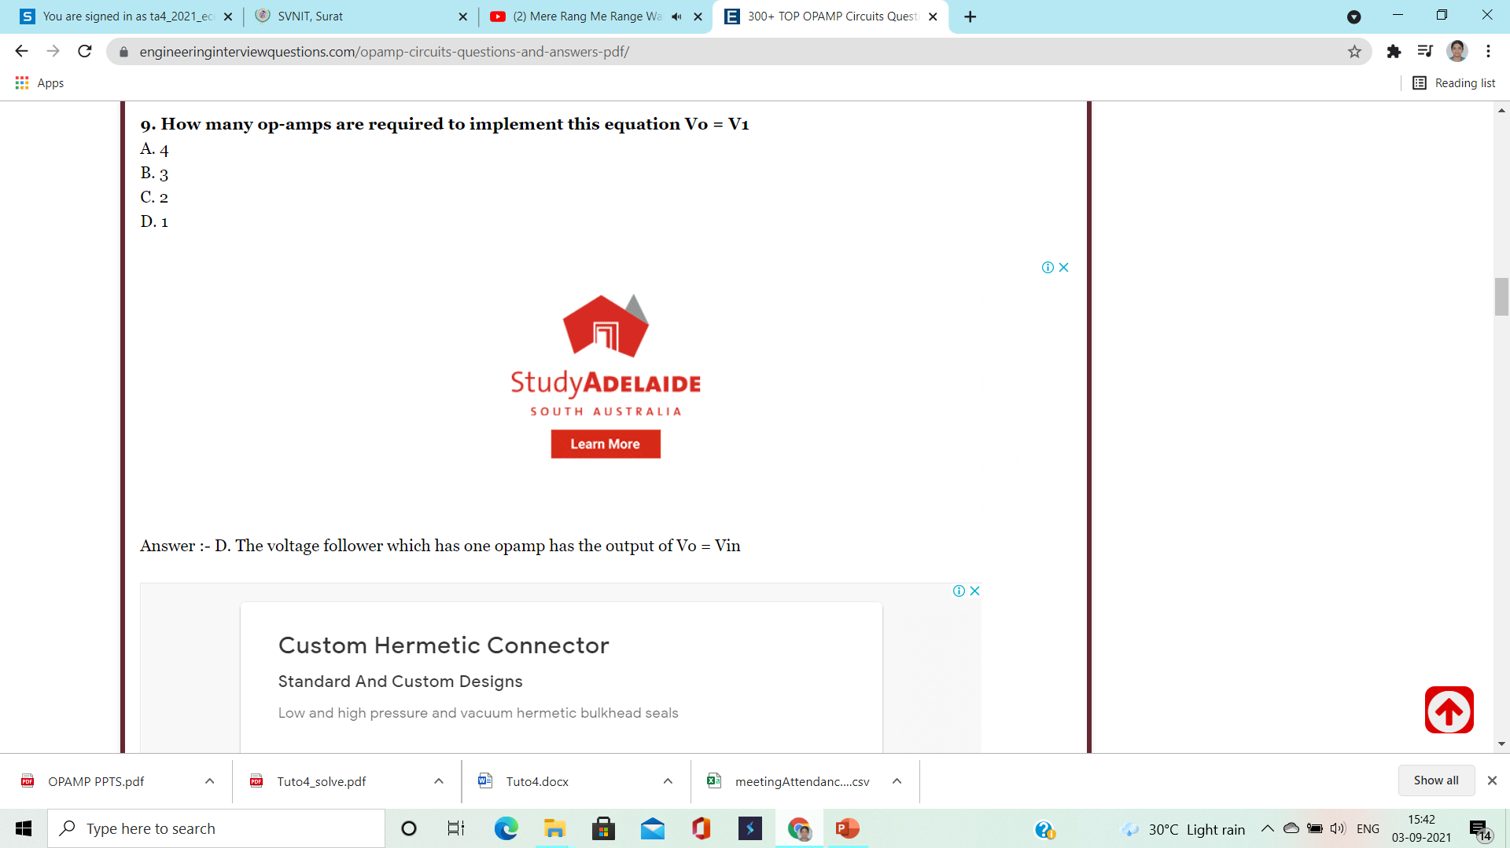
(3)

Slide 6
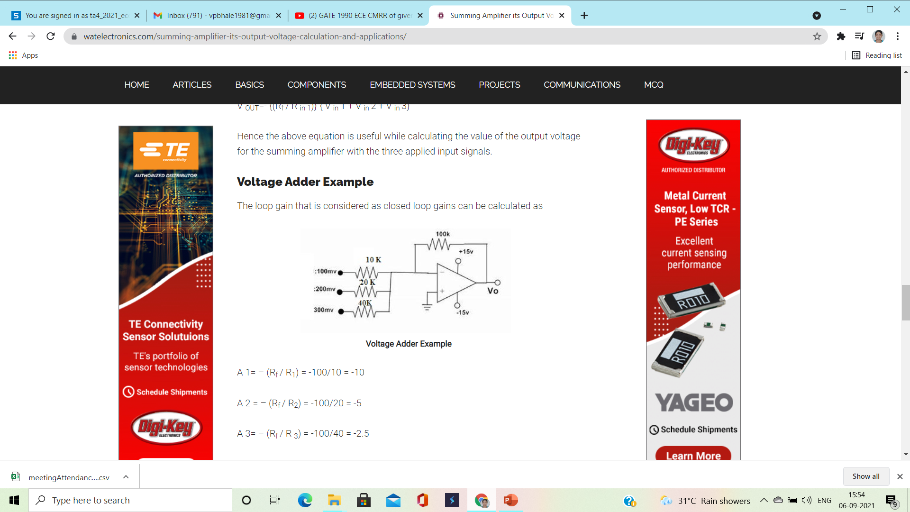
(4)

Slide 7
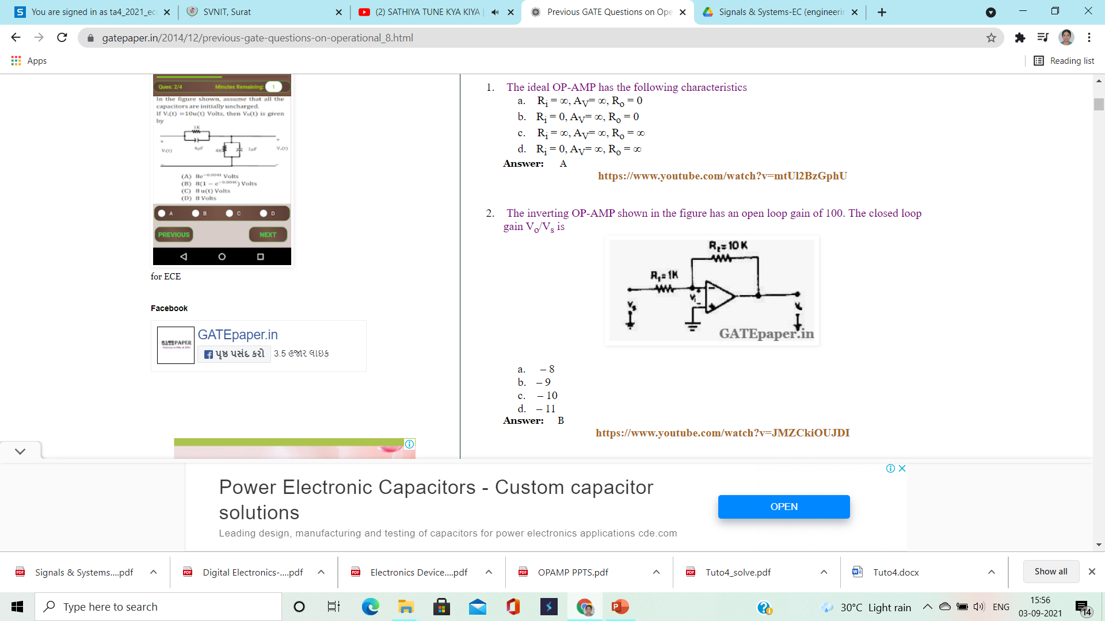
(5)

Slide 9
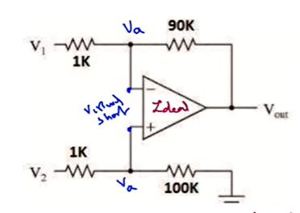
(8) Calculate the CMRR for the differential amplifier shown

Slide 10
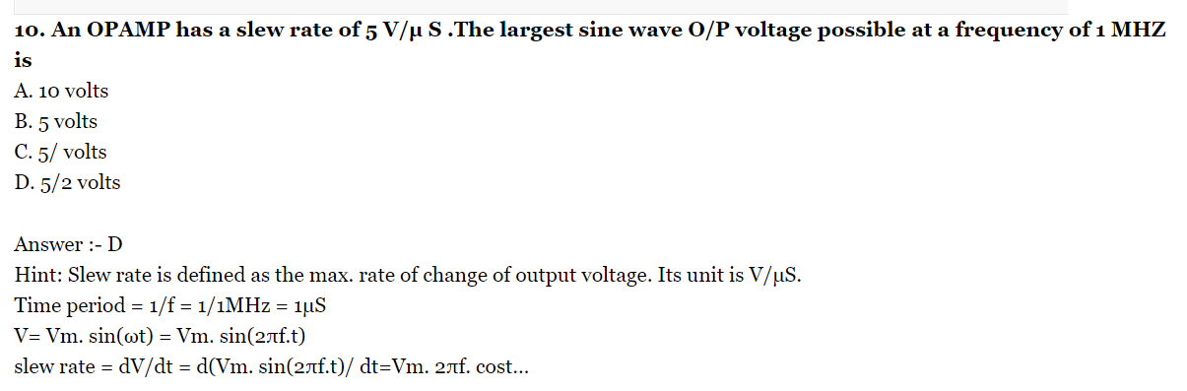
(9)

